Slide 1
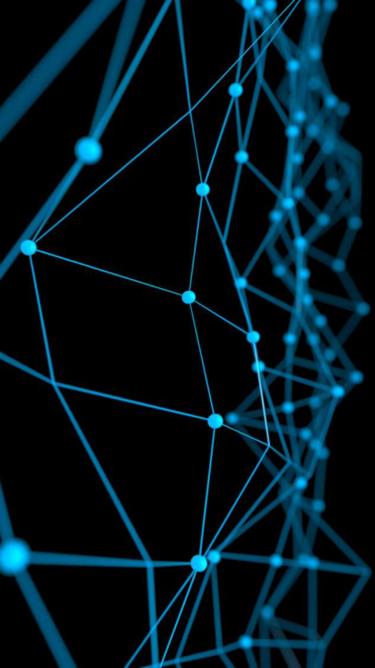
Deep Learning for Natural Language Processing:
Basic
June 2019

Slide 2
Introduction

Slide 3
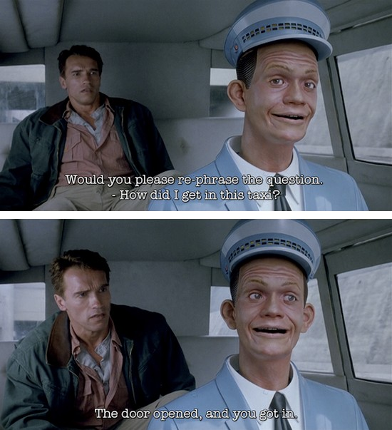
What is Natural Language Processing (NLP)?
Natural language processing is a ﬁeld at the intersection of
computer science
artiﬁcial intelligence
and linguistics.
Goal: for computers to process or “understand” natural language in order to perform tasks that are useful, e.g.
Question Answering
Fully understanding and representing the meaning of language (or even deﬁning it) is an illusive goal.
Perfect language understanding is AI-complete

Slide 4
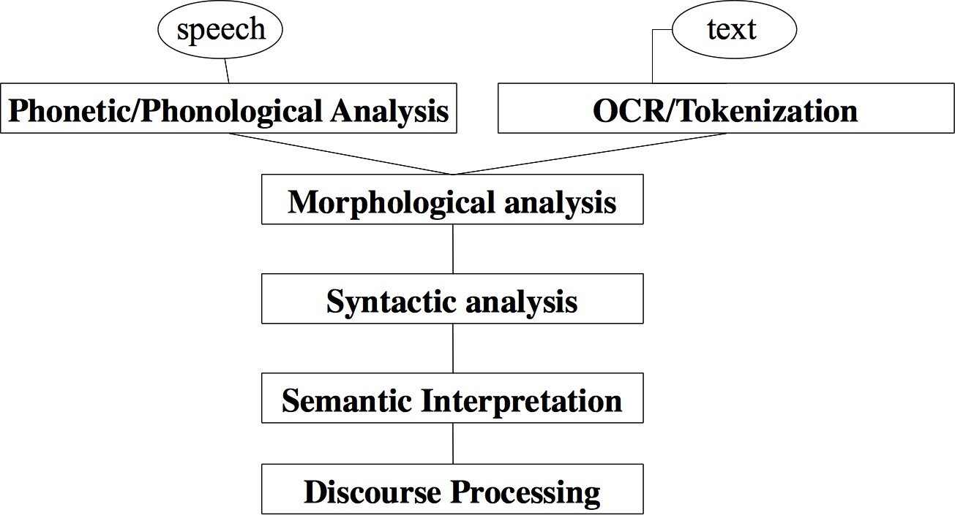
NLP Levels
Christopher Manning & Abigail See

Slide 5
NLP Applications
Spell checking, keyword search, ﬁnding synonyms
Extracting information from websites such as
product price, dates, location, people or company names
Classifying, reading level of school texts, positive/negative sentiment of longer documents
Machine translation
Spoken dialog systems
Complex question answering
Christopher Manning & Abigail See

Slide 6
NLP in Industry
Search (written and spoken)
Online advertisement
Automated/assisted translation
Sentiment analysis for marketing or ﬁnance/trading
Speech recognition
Automating customer support
Christopher Manning & Abigail See

Slide 7
Why is NLP hard?
NLP is hard for two primary reasons:
humans don’t always express intent through semantically accurate language
there are numerous ambiguities in language.
Christopher Manning & Abigail See

Slide 8
Deep Learning + NLP = Deep NLP
Combine ideas and goals of NLP and use representation learning and deep learning methods to solve them
Several big improvements in recent years across diﬀerent NLP
levels: speech, morphology, syntax, semantics
applications: machine translation, sentiment analysis and question answering
Christopher Manning & Abigail See

Slide 9
Representations at NLP Levels: Morphology
Traditional: Morphemes preﬁx stem suﬃx
un interest ed
Deep Learning:
every morpheme is a vector
a neural network combines two vectors into one vector
Thang et al. 2013
unfortunately_{STM}
W , b
m m
unfortunate_{STM}
W_{m}, b_{m}
^{ly}SUF
^{un}PRE
fortunate_{STM}
Christopher Manning & Abigail See

Slide 10
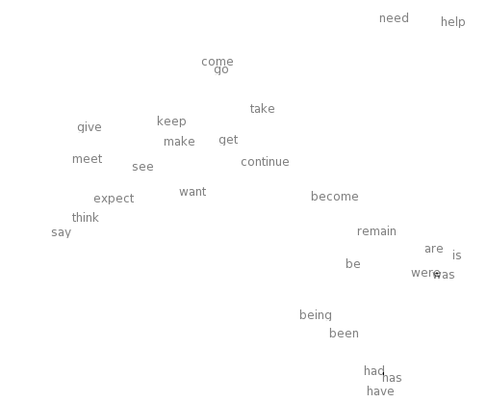
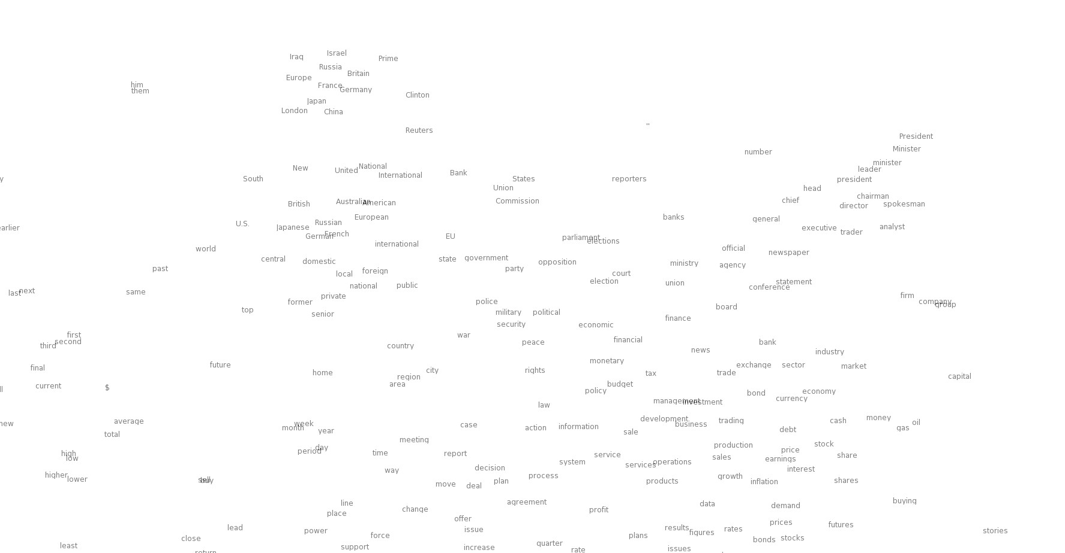
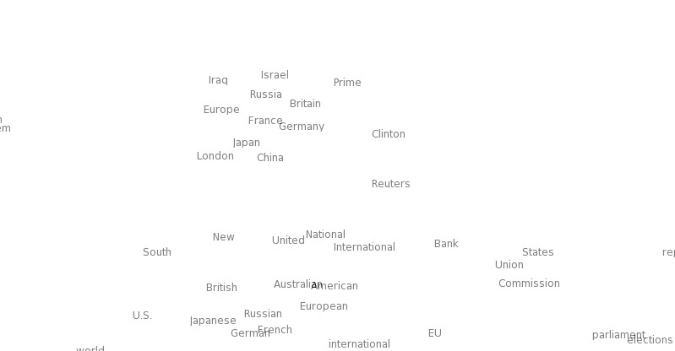

Neural word vectors - visualization
23
Christopher Manning & Abigail See

Slide 11
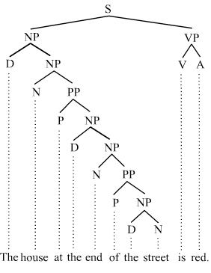
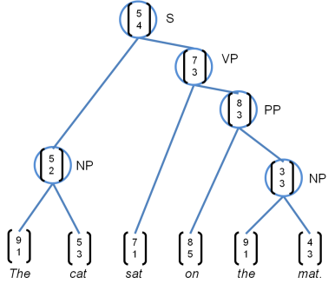
Representations at NLP Levels: Syntax
Traditional: Phrases
Discrete categories like NP, VP
Deep Learning:
Every word and every phrase is a vector
a neural network combines two vectors into one vector
Socher et al. 2011
Christopher Manning & Abigail See

Slide 12
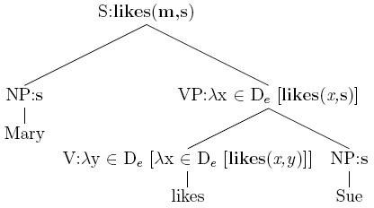
Representations at NLP Levels: Semantics
Traditional: Lambda calculus
Carefully engineered functions
Take as inputs speciﬁc other functions
No notion of similarity or fuzziness of language
Deep Learning:
Every phrase and every logical expression is a vector
a neural network combines two vectors into one vector
Bowman et al. 2014
Softmax classifier
P (@)= 0.8
Comparison N(T)N layer
all reptiles walk vs. some turtles move
Composition
all reptiles walk
some turtles move
RN(T)N
layers
all reptiles
walk
some turtles
move
all
reptiles
some
turtles
Christopher Manning & Abigail See

Slide 13
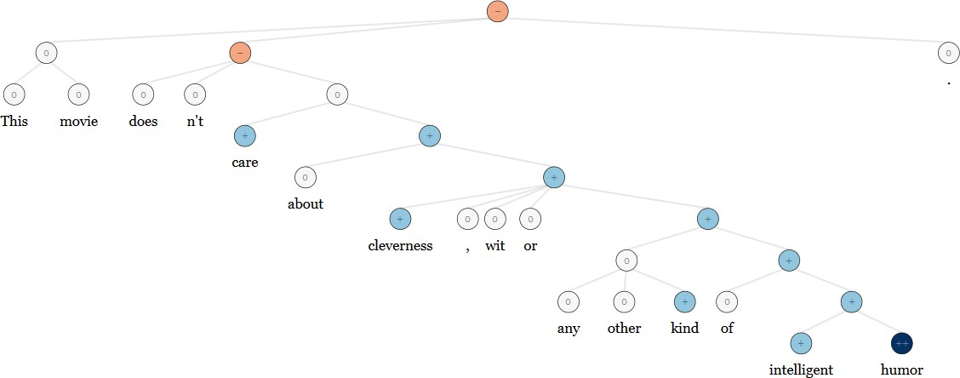
NLP Applications: Sentiment Analysis
Traditional: Curated sentiment dictionaries combined with either bag-of-words representations (ignoring word order) or hand-designed negation features (ain’t gonna capture everything)
Same deep learning model that was used for morphology, syntax and logical semantics can be used! ->RecursiveNN!
Christopher Manning & Abigail See

Slide 14
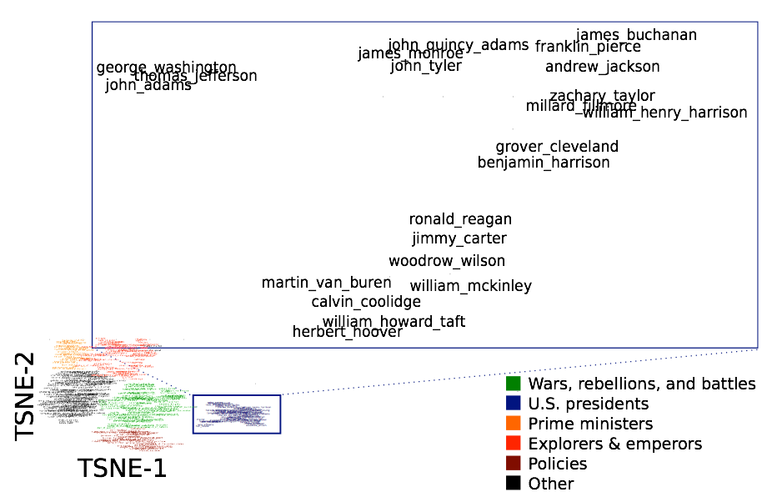
Question Answering
Common: A lot of feature engineering to capture world and other knowledge, e.g. regular expressions, Berant et al. (2014)
Is main verb trigger?
Yes No
Condition | Regular Exp.
Wh- word subjective? Wh- word object? | AGENT THEME
Condition | Regular Exp.
default DIRECT PREVENT | (ENABLE|SUPER)⁺ (ENABLE|SUPER) (ENABLE|SUPER)⇤PREVENT(ENABLE|SUPER)⇤
DL: Same deep learning model that was used for morphology, syntax, logical semantics and sentiment can be used!
Facts are stored in vectors
Christopher Manning & Abigail See

Slide 15
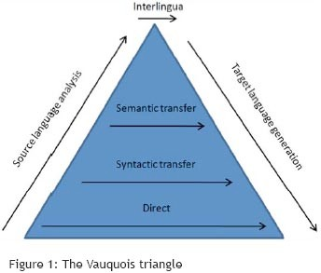
Machine Translation
Many levels of translation have been tried in the past:
Traditional MT systems are very large complex systems
Christopher Manning & Abigail See

Slide 16
Machine Translation
Source sentence mapped to vector, then output sentence generated.
Sequence to Sequence Learning with Neural Networks by Sutskever et al. 2014; Luong et al. 2016
About to replace very complex hand engineered architectures
Christopher Manning & Abigail See

Slide 17
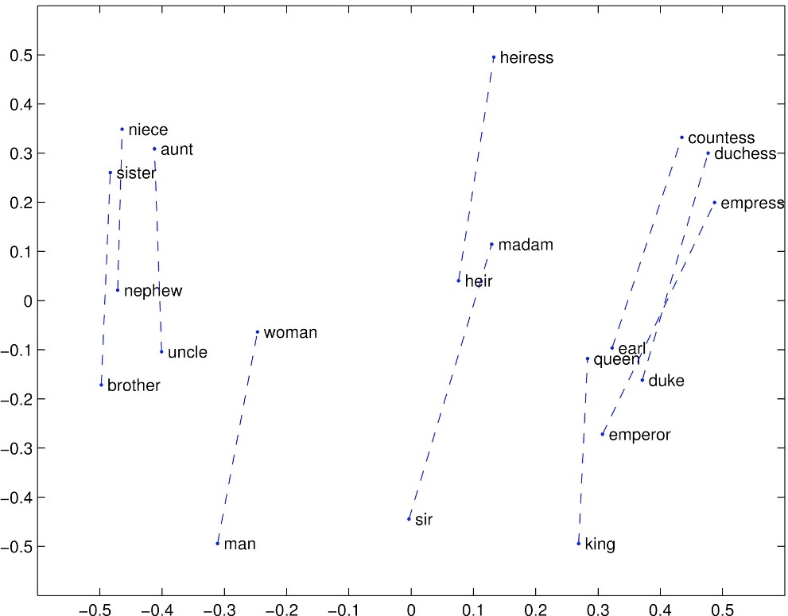
Representation for all levels: Vectors
We will learn in the next part how we can learn vector representations for words and what they actually represent.
Christopher Manning & Abigail See

Slide 18
Word Embedding: Word2Vec

Slide 19
How do we represent the meaning of a word?
Deﬁnition: Meaning (Webster dictionary)
the idea that is represented by a word, phrase, etc.
the idea that a person wants to express by using words, signs, etc.
the idea that is expressed in a work of writing, art, etc.
Christopher Manning & Abigail See

Slide 20
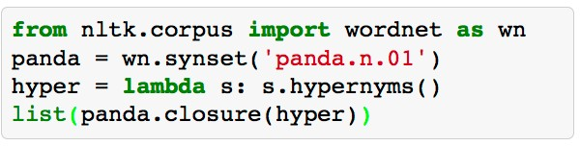
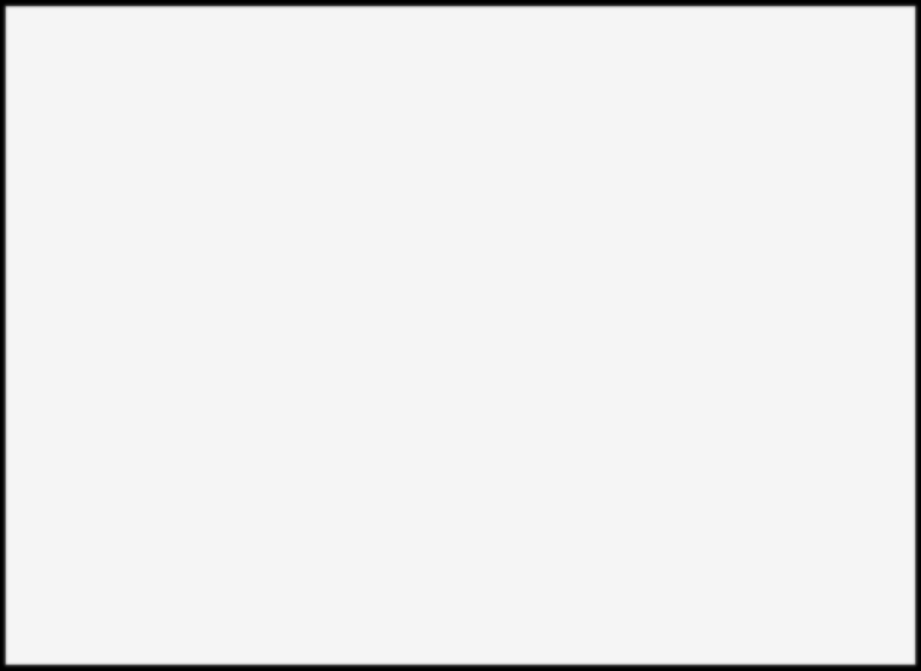
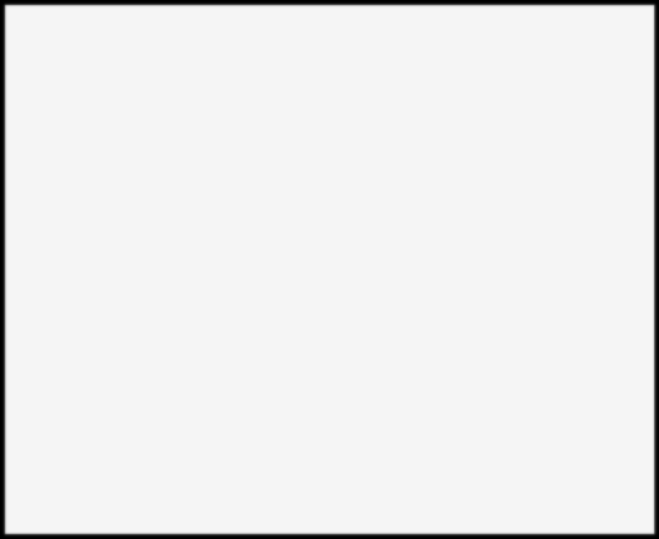
How to represent meaning in a computer?
Common answer: Use a taxonomy like WordNet that has
hypernyms (is-a) relationships
and
synonym sets (good):
[Synset('procyonid.n.01'), Synset('carnivore.n.01'), Synset('placental.n.01'), Synset('mammal.n.01'), Synset('vertebrate.n.01'), Synset('chordate.n.01'), Synset('animal.n.01'), Synset('organism.n.01'), Synset('living_thing.n.01'), Synset('whole.n.02'),
Synset('object.n.01'),
Synset('physical_entity.n.01'), Synset('entity.n.01')]
S: (adj) full, good
S: (adj) estimable, good, honorable, respectable S: (adj) beneﬁcial, good
S: (adj) good, just, upright
S: (adj) adept, expert, good, practiced,
proﬁcient, skillful
S: (adj) dear, good, near S: (adj) good, right, ripe
…
S: (adv) well, good
S: (adv) thoroughly, soundly, good
S: (n) good, goodness
S: (n) commodity, trade good, good
Christopher Manning & Abigail See

Slide 21
Problems with this discrete representation
Great as resource but missing nuances, e.g. synonyms:
adept, expert, good, practiced, proﬁcient, skillful?
→ Hard to compute accurate word similarity
Missing new meanings of words
e.g. wicked, badass, nifty, wizard, genius, ninja, bombest
Impossible to keep up-to-date!
Subjective
Requires human labor to create and adapt
Christopher Manning & Abigail See

Slide 22
Representing words as discrete symbols
In traditional NLP, we regard words as discrete symbols: hotel, conference, motel
Means one 1, the rest 0s
Words can be represented by one-hot vectors:
motel = [0 0 0 0 0 0 0 0 0 0 1 0 0 0 0]
hotel = [0 0 0 0 0 0 0 1 0 0 0 0 0 0 0]
Vector dimension = number of words in vocabulary (e.g. 500,000)
Christopher Manning & Abigail See

Slide 23
Representing words as discrete symbols
Sec. 9.2.2
Example: in web search, if user searches for “Seattle motel”, we would like to match documents containing “Seattle hotel”.
But:
motel = [0 0 0 0 0 0 0 0 0 0 1 0 0 0 0]
hotel = [0 0 0 0 0 0 0 1 0 0 0 0 0 0 0]
These two vectors are orthogonal.
There is no natural notion of similarity for one-hot vectors!
Solution:
Could rely on WordNet’s list of synonyms to get similarity?
Instead: learn to encode similarity in the vectors themselves
Christopher Manning & Abigail See

Slide 24
Representing words by their context
Core idea: A word’s meaning is given by the words that frequently appear close-by
“You shall know a word by the company it keeps” (J. R. Firth 1957: 11)
One of the most successful ideas of modern statistical NLP!
When a word w appears in a text, its context is the set of words that appear nearby (within a fixed-size window).
Use the many contexts of w to build up a representation of w
…government debt problems turning into
…saying that Europe needs unified
…India has just given its
banking
banking banking
crises as happened in 2009…
regulation to replace the hodgepodge… system a shot in the arm…
These context words will represent banking

Slide 25
Word vectors
We will build a dense vector for each word, chosen so that it is similar to vectors of words that appear in similar contexts.
0.286
0.792
−0.177
−0.107
0.109
−0.542
0.349
0.271
linguistics =
Note: word vectors are sometimes called word embeddings or word representations.
Christopher Manning & Abigail See

Slide 26
How to make neighbors represent words?
Answer: With a cooccurrence matrix X
2 options: full document vs windows
Word - document cooccurrence matrix will give general topics (all sports terms will have similar entries) leading to “Latent Semantic Analysis”
Instead: Window around each word -> captures both syntactic (POS) and semantic information
Christopher Manning & Abigail See

Slide 27
Window based cooccurence matrix
Window length 1 (more common: 5 - 10)
Symmetric (irrelevant whether leX or right context)
Example corpus:
I like deep learning.
I like NLP.
I enjoy ﬂying.
Christopher Manning & Abigail See

Slide 28
Window based cooccurence matrix
counts | I | like | enjoy | deep | learning | NLP | ﬂying | .
I | 0 | 2 | 1 | 0 | 0 | 0 | 0 | 0
like | 2 | 0 | 0 | 1 | 0 | 1 | 0 | 0
enjoy | 1 | 0 | 0 | 0 | 0 | 0 | 1 | 0
deep | 0 | 1 | 0 | 0 | 1 | 0 | 0 | 0
learning | 0 | 0 | 0 | 1 | 0 | 0 | 0 | 1
NLP | 0 | 1 | 0 | 0 | 0 | 0 | 0 | 1
ﬂying | 0 | 0 | 1 | 0 | 0 | 0 | 0 | 1
. | 0 | 0 | 0 | 0 | 1 | 1 | 1 | 0
Example corpus:
I like deep learning.
I like NLP.
I enjoy ﬂying.

Slide 29
Problems with simple cooccurrence vectors
Increase in size with vocabulary
Very high dimensional: require a lot of storage
Subsequent classiﬁcation models have sparsity issues
→ Models are less robust
Christopher Manning & Abigail See

Slide 30
Solution: Low dimensional vectors
Idea: store “most” of the important information in a ﬁxed, small number of dimensions: a dense vector
Usually around 25 – 1000 dimensions
How to reduce the dimensionality?
Christopher Manning & Abigail See

Slide 31
Method 1: Dimensionality Reduction on X
Singular Value Decomposition of cooccurrence matrix X.
m
r
r
m
_{U1U2U3} . . .
S₁
S₂
0
V1
V2
n
=
n
r
S_{3 .}
r
V3
. .
.
.
0
Sr
.
X
m
U
S
T
V
k
k
m
U₁U₂U3 . .
S₁
0
S_{3 . .}
Sk
V1
n
=
n
k
S
2
k
V2
V.3
0
.
X
U
S
T
V
X is the best rank k approximation to X , in terms of least squares.
Christopher Manning & Abigail See

Slide 32
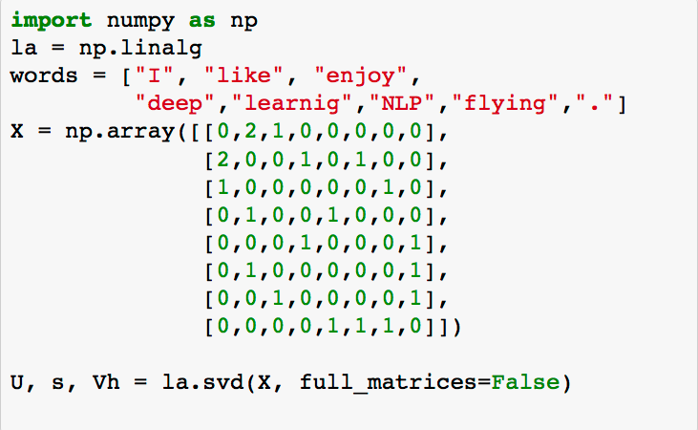
Simple SVD word vectors in Python
Corpus:
I like deep learning. I like NLP. I enjoy ﬂying.
Christopher Manning & Abigail See

Slide 33
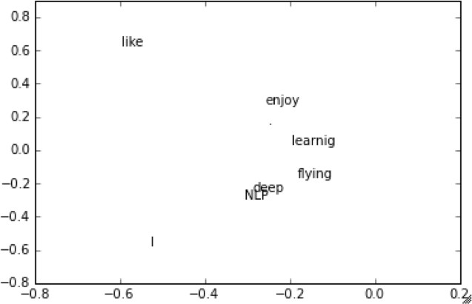
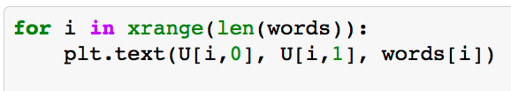
Simple SVD word vectors in Python
Corpus: I like deep learning. I like NLP. I enjoy ﬂying.
Printing ﬁrst two columns of U corresponding to the 2 biggest singular values
Christopher Manning & Abigail See

Slide 34
Hacks to X
Problem: function words (the, he, has) are too frequent -> syntax has too much impact. Some ﬁxes:
min(X,t), with t~100
Ignore them all
Ramped windows that count closer words more
Use Pearson correlations instead of counts, then set negative values to 0
Christopher Manning & Abigail See

Slide 35
Interesting semantic paPers emerge in the vectors
WRIST ANKLE
SHOULDER ARM
LEG HAND
FOOT HEAD
NOSE FINGER
TOE FACE
EAR
EYE
TOOTH DOG
CAT
PUPPY KITTEN
COW MOUSE
TURTLE OYSTER
LION BULL CHICAGO ATLANTA
MONTREAL NASHVILLE
TOKYO
CHINA RUSSIA AFRICA ASIA EUROPE
AMERICA
BRAZIL
MOSCOW FRANCE
HAWAII
An Improved Model of Semantic Similarity Based on Lexical Co-Occurrence Rohde et al. 2005
Christopher Manning & Abigail See

Slide 36
Interesting syntactic paPers emerge in the vectors
CHOOSING
CHOOSE CHOSCEHNOSE
STOLEN STEAL
STOLE
STEALING
SPOKE
SPEAK
TAKE
SPOKEN
TAKEN
SPEAKING
TAKING TOOK
THROW^{T}N^{HR}T^{O}H^{W}REW
THROWING
SHOWN
SHOWED SHOWING
EATEN_{T}
ATE
EATING
SHOW
GROWN
GROW
GREW
GROWING
An Improved Model of Semantic Similarity Based on Lexical Co-Occurrence Rohde et al. 2005
Christopher Manning & Abigail See

Slide 37
Interesting semantic paPers emerge in the vectors
DRIVER
JANITOR STUDENT
DRIVE
SWIMMER
CLEAN
TEACHER
DOCTOR
BRIDE
SWIM
PRIEST
LEARN
TEACH
MARRY
TREAT
PRAY
An Improved Model of Semantic Similarity Based on Lexical Co-Occurrence Rohde et al. 2005
Christopher Manning & Abigail See

Slide 38
Problems with SVD
Computational cost scales quadratically
->Bad for millions of words or documents
Hard to incorporate new words or documents
Diﬀerent learning regime than other DL models
Christopher Manning & Abigail See

Slide 39
Idea: Directly learn low-dimensional word vectors
Old idea. Relevant for this lecture & deep learning:
Learning representations by back-propagating errors. (Rumelhart et al., 1986)
A neural probabilistic language model (Bengio et al., 2003)
NLP (almost) from Scratch (Collobert & Weston, 2008)
A recent, even simpler and faster model: word2vec (Mikolov et al. 2013) → intro now
Christopher Manning & Abigail See

Slide 40
Word2vec: Overview
Word2vec (Mikolov et al. 2013) is a framework for learning word vectors. Idea:
We have a large corpus of text
Every word in a fixed vocabulary is represented by a vector
Go through each position t in the text, which has a center word
c and context (“outside”) words o
Use the similarity of the word vectors for c and o to calculate the probability of o given c (or vice versa)
Keep adjusting the word vectors to maximize this probability
Christopher Manning & Abigail See

Slide 41
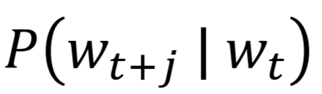
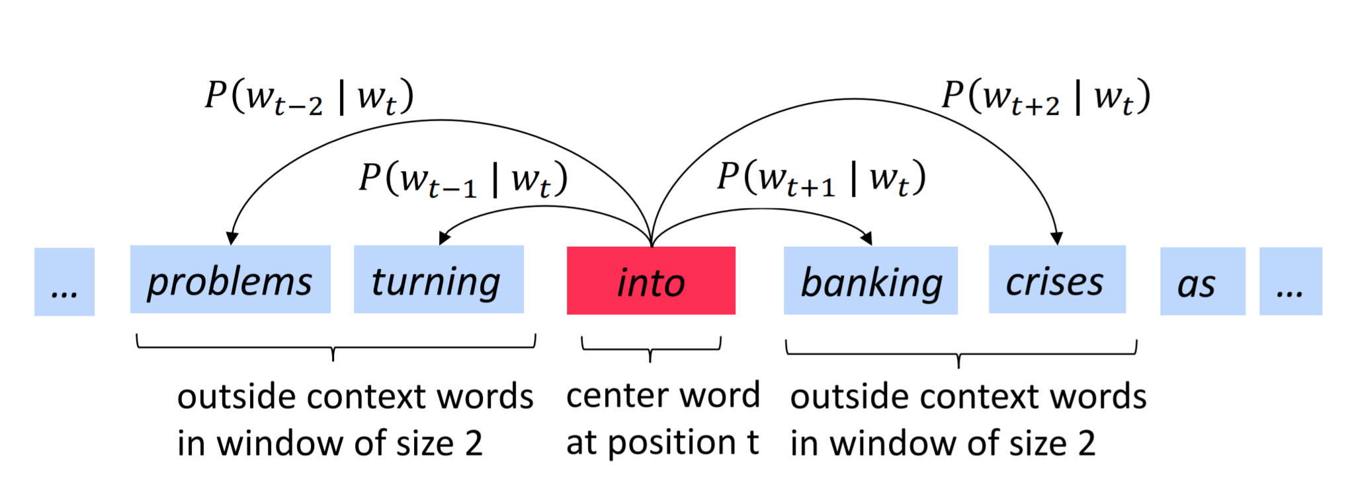
Word2vec: Overview
Example windows and process for computing
Christopher Manning & Abigail See

Slide 42
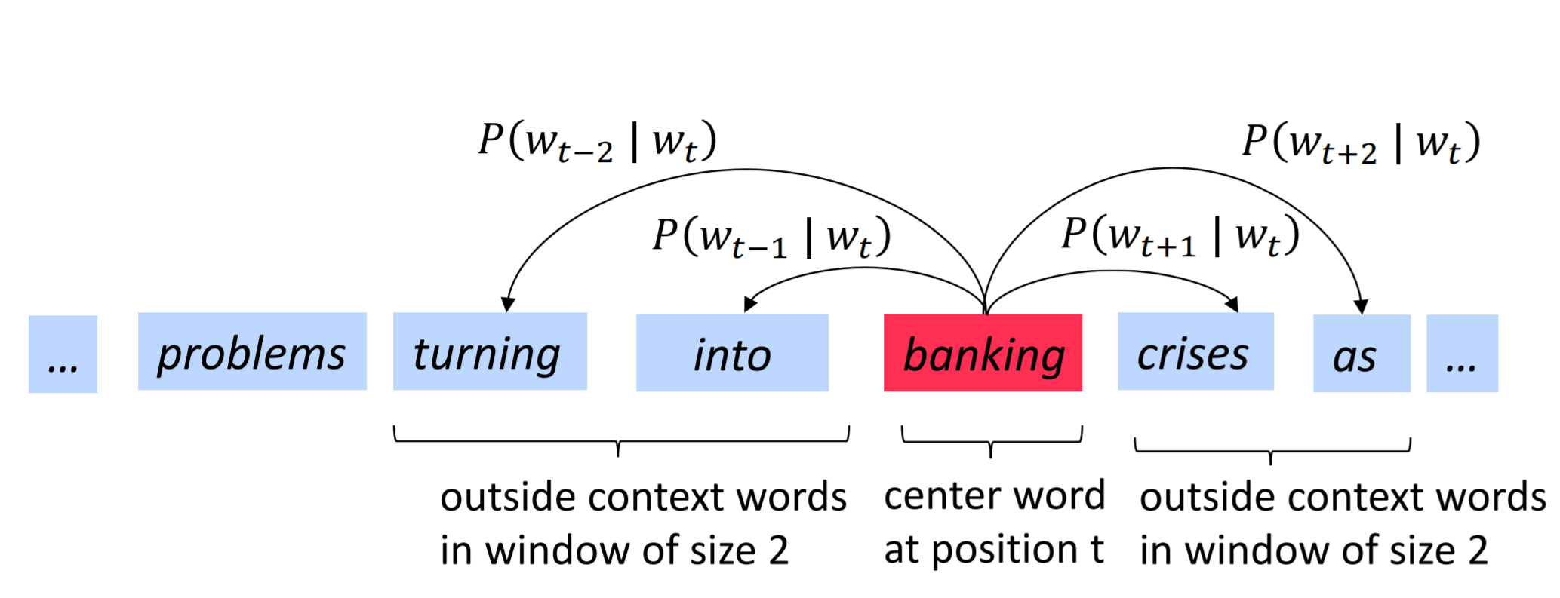
Word2vec: Overview
Example windows and process for computing
Christopher Manning & Abigail See

Slide 43
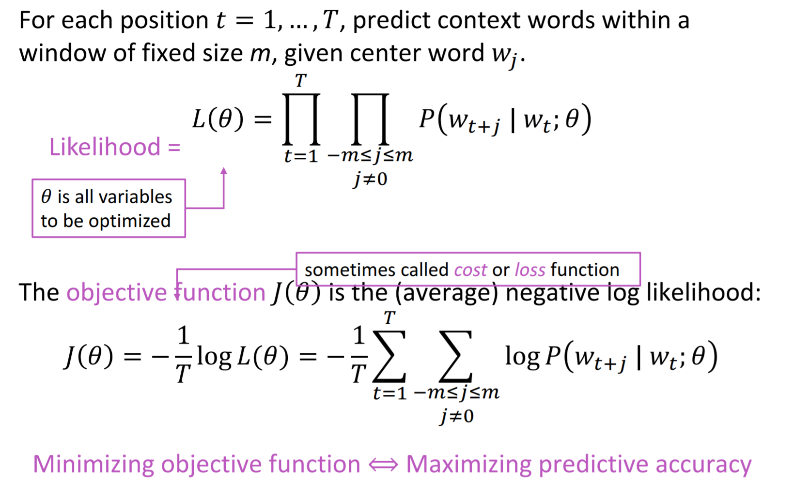
Word2vec: objective function
Christopher Manning & Abigail See

Slide 44
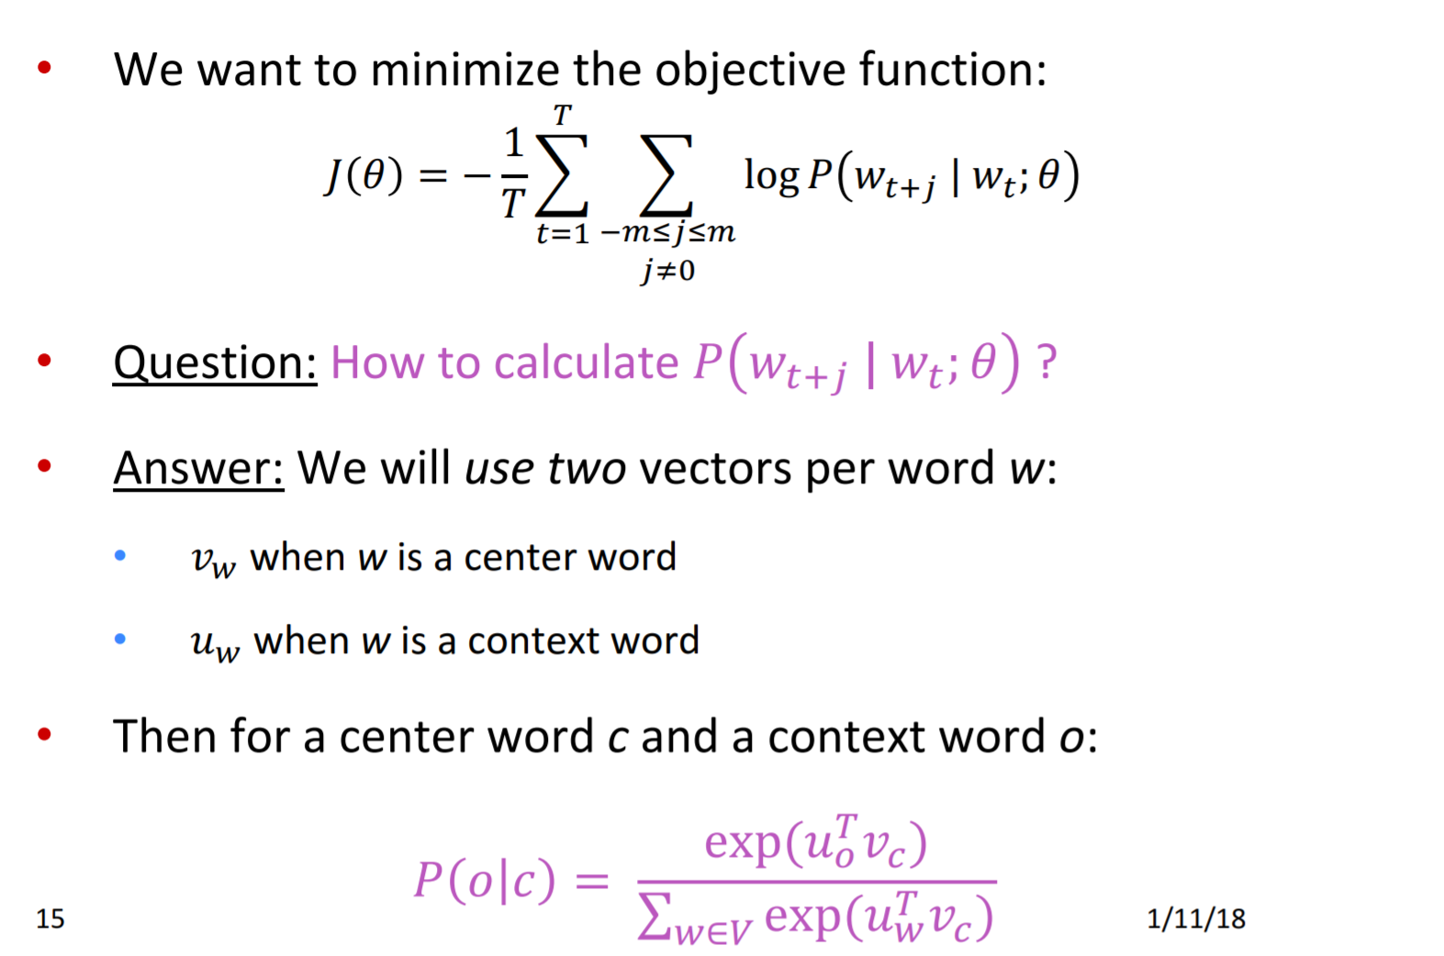
Word2vec: objective function
Christopher Manning & Abigail See

Slide 45
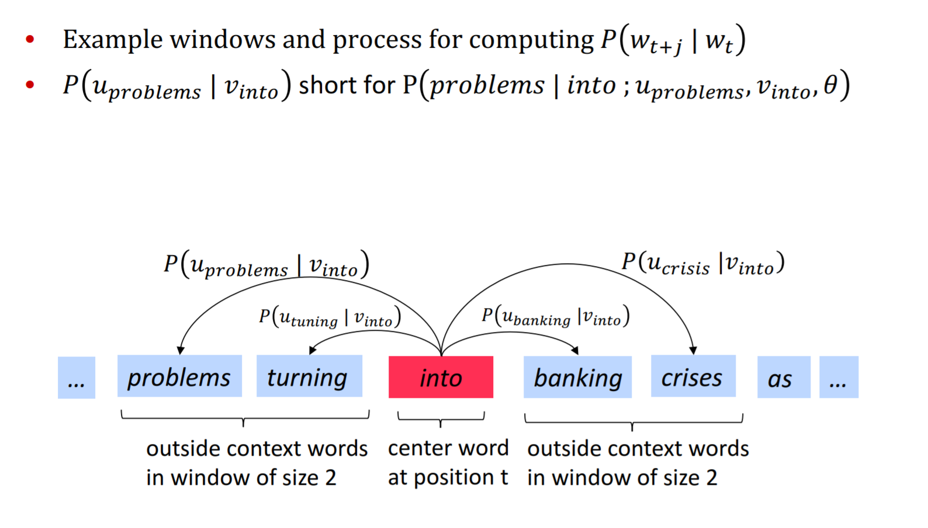
Word2Vec Overview with Vectors
Christopher Manning & Abigail See

Slide 46
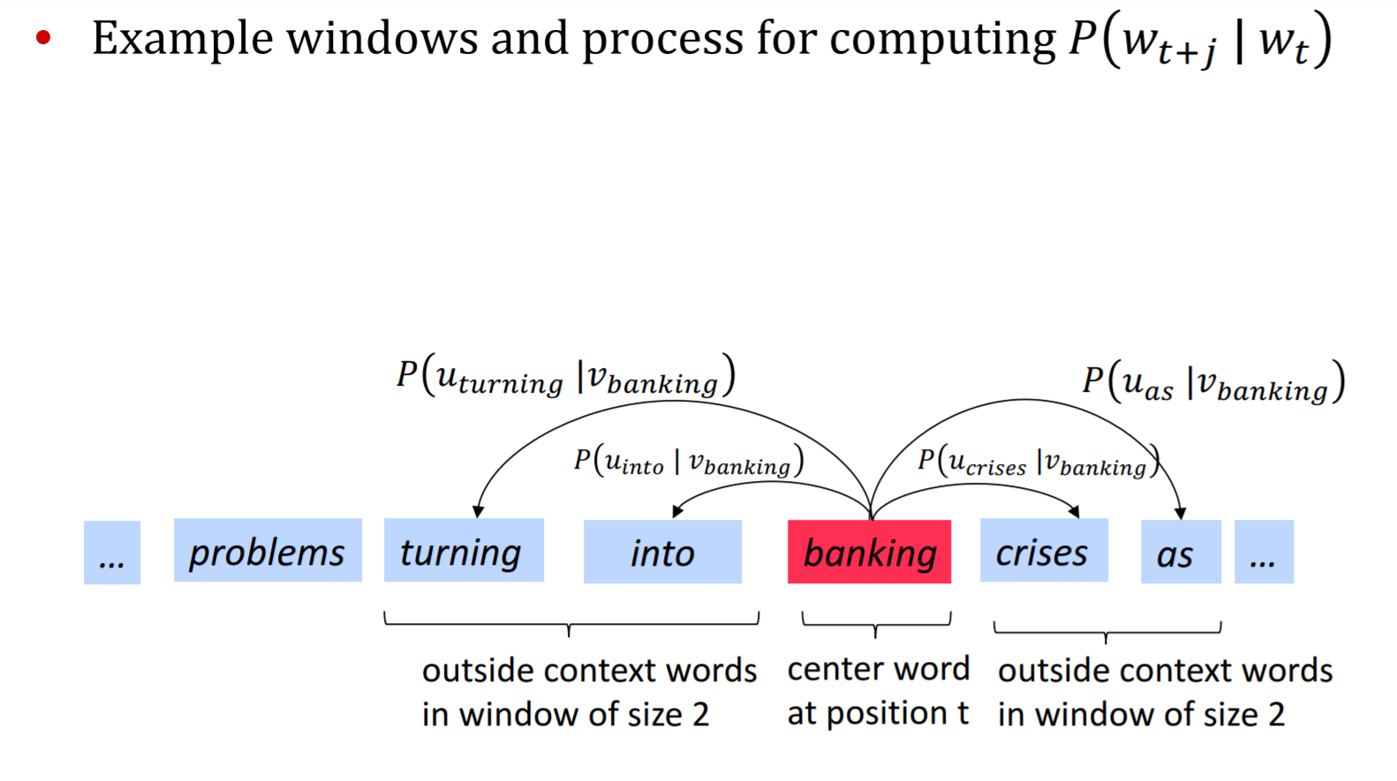
Word2Vec Overview with Vectors
Christopher Manning & Abigail See

Slide 47
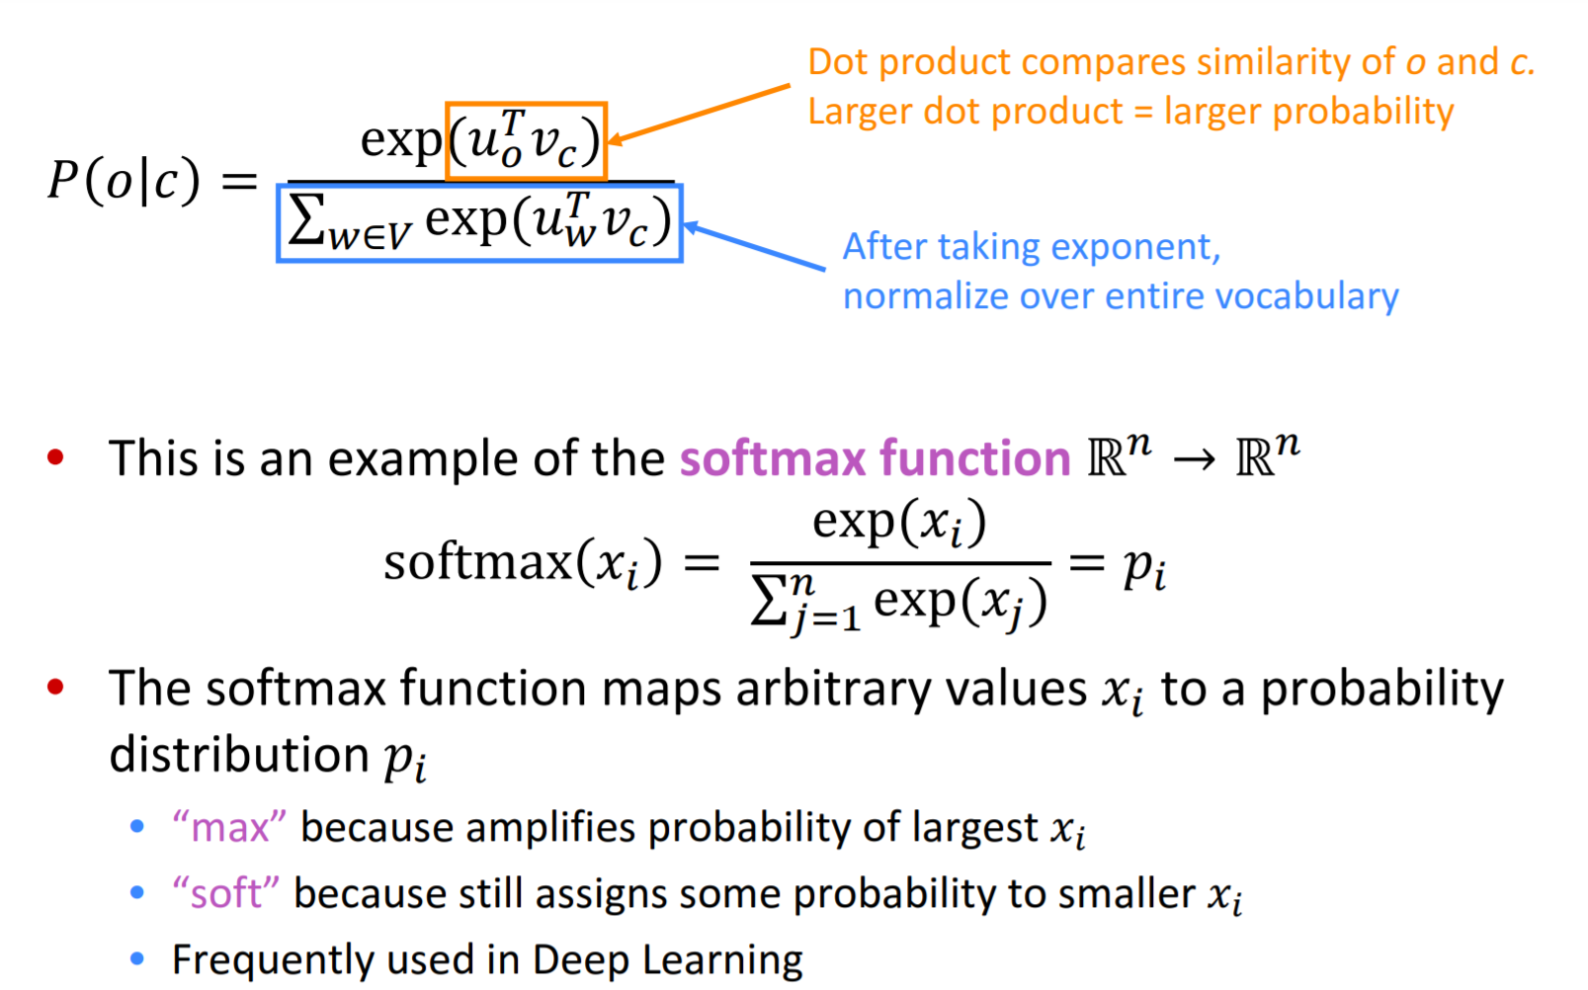
Word2vec: prediction function
Christopher Manning & Abigail See

Slide 48
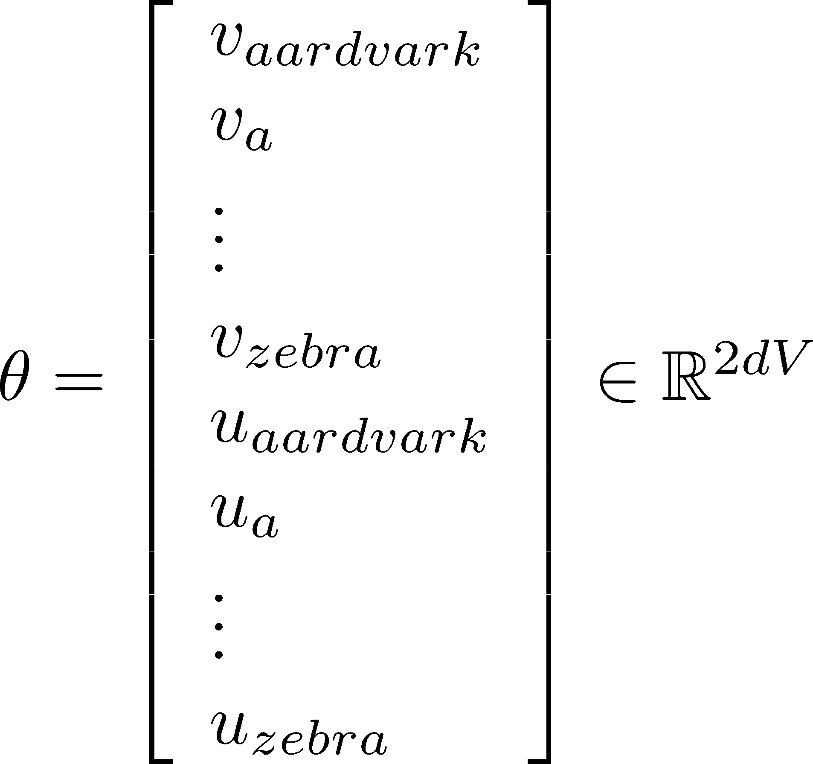
To train the model: Compute all vector gradients!
Recall: 𝜃 represents all model parameters, in one long vector
In our case with d-dimensional vectors and V-many words:
Remember: every word has two vectors
We then optimize these parameters
Christopher Manning & Abigail See

Slide 49
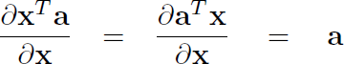
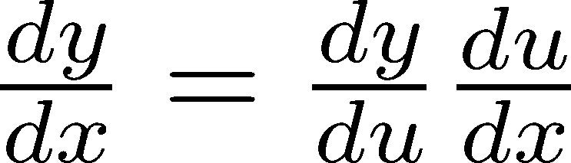
Derivations of gradient
The basic Lego piece
Useful basics:
If in doubt: write out with indices
Chain rule! If y = f(u) and u = g(x), i.e. y = f(g(x)), then:
Christopher Manning & Abigail See

Slide 50
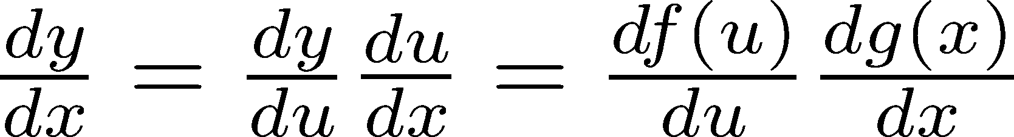
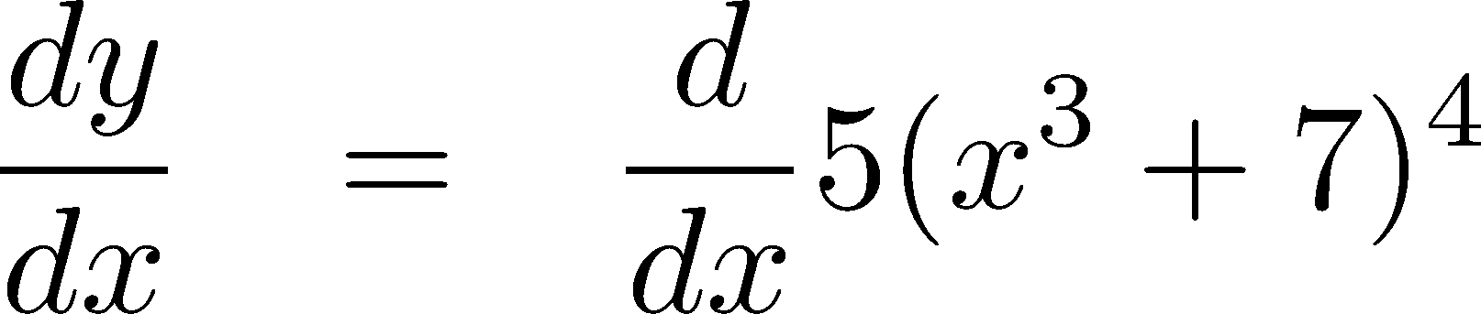
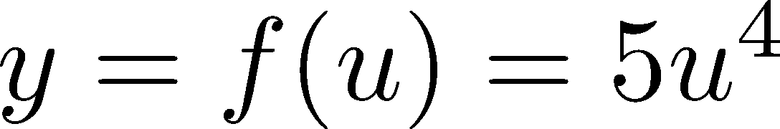
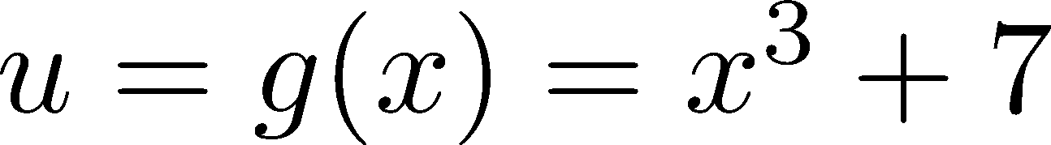
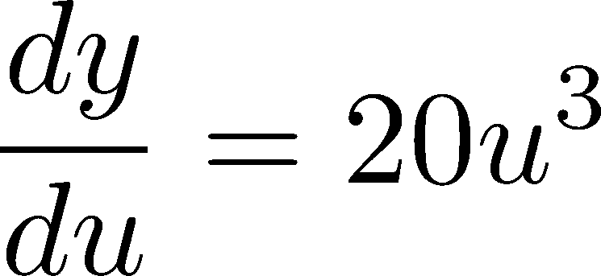
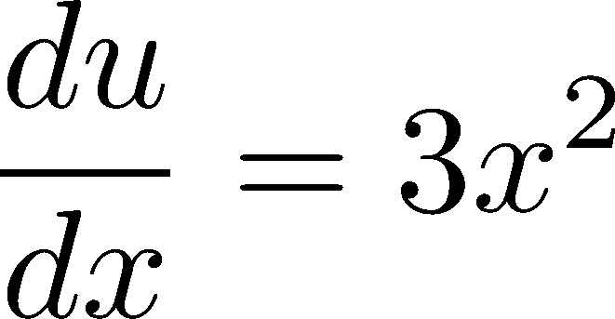
Chain Rule
Chain rule! If y = f(u) and u = g(x), i.e. y = f(g(x)), then:
Simple example:
Christopher Manning & Abigail See

Slide 51
Word2vec: More details
Why two vectors? → Easier optimization. Average both at the end.
Two model variants:
Skip-grams (SG)
Predict context (”outside”) words (position independent) given center word
Continuous Bag of Words (CBOW)
Predict center word from (bag of) context words
This lecture so far: Skip-gram model
Additional efficiency in training:
1. Negative sampling
So far: Focus on naïve softmax (simpler training method)
Christopher Manning & Abigail See

Slide 52


Count based vs direct prediction
NNLM, HLBL, RNN, Skip- gram/CBOW, (Bengio et al; Collobert & Weston; Huang et al; Mnih & Hinton; Mikolov et al; Mnih & Kavukcuoglu)
Scales with corpus size
Inefficient usage of statistics
Generate improved performance on other tasks
Can capture complex patterns beyond word similarity
LSA, HAL (Lund & Burgess), COALS (Rohde et al),
Hellinger-PCA (Lebret & Collobert)
Fast training
Efficient usage of statistics
Primarily used to capture word similarity
Disproportionate importance given to large counts
Christopher Manning & Abigail See

Slide 53
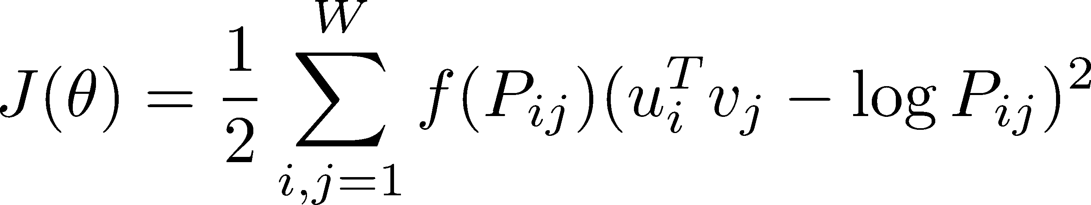
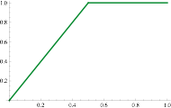
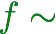
Combining the best of both worlds: GloVe
Fast training
Scalable to huge corpora
Good performance even with small corpus, and small vectors
Christopher Manning & Abigail See

Slide 54
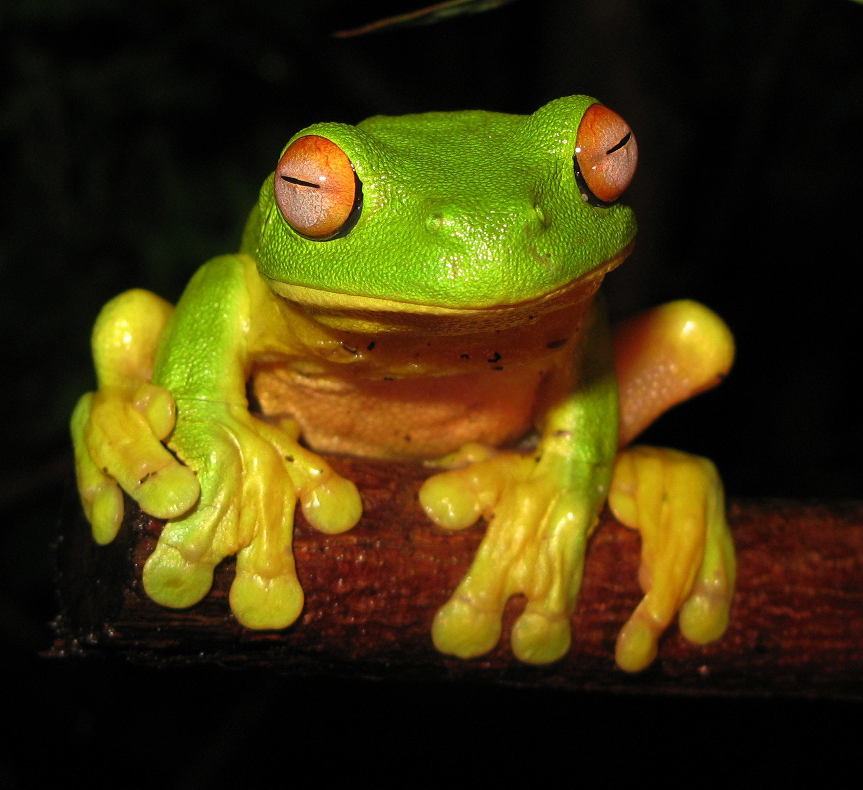
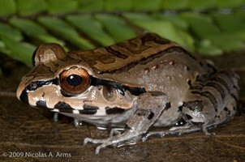
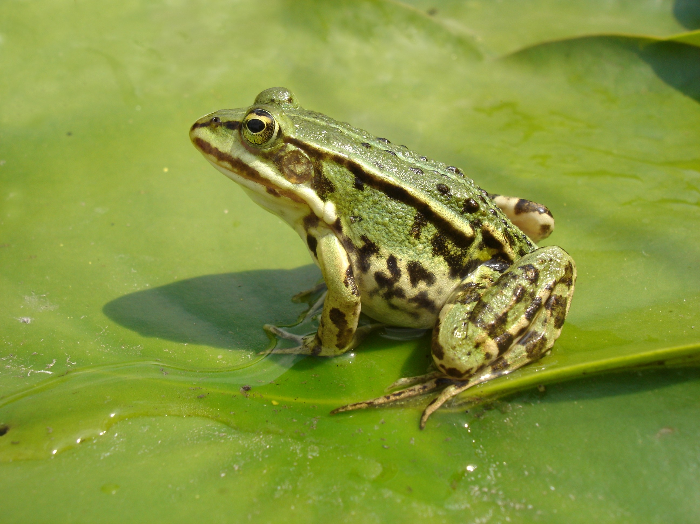
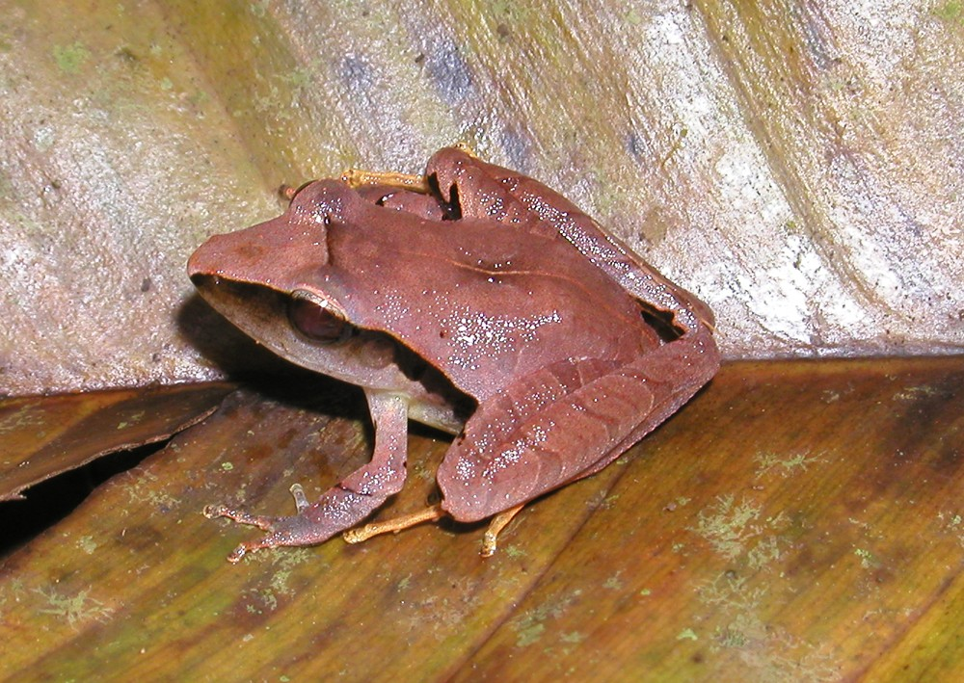
Glove results
Nearest words to frog:
frogs
toad
litoria
leptodactylidae
rana
lizard
eleutherodactylus
litoria
leptodactylidae
rana
eleutherodactylus
Christopher Manning & Abigail See

Slide 55


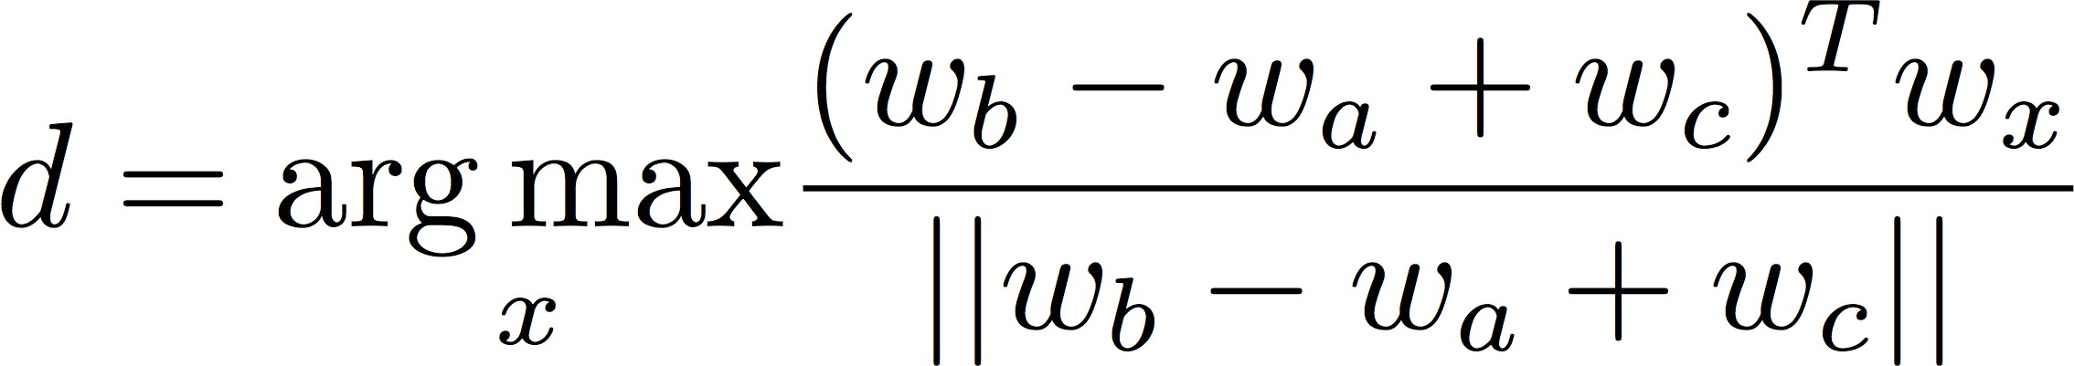

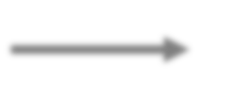
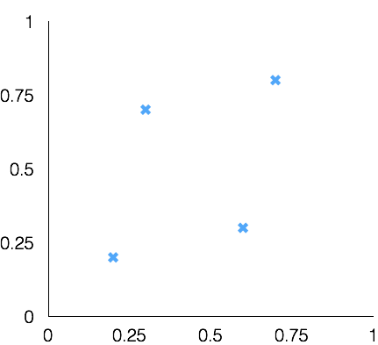
Test for linear relationships, examined by Mikolov et al. (2014)
Word Analogies
a:b :: c:?
man:woman :: king:?
+ | king | [ 0.30 0.70 ]
- | man | [ 0.20 0.20 ]
+ | woman | [ 0.60 0.30 ]
 | queen | [ 0.70 0.80 ]
queen
king
woman
man
Christopher Manning & Abigail See

Slide 56
Glove Visualizations
Christopher Manning & Abigail See

Slide 57
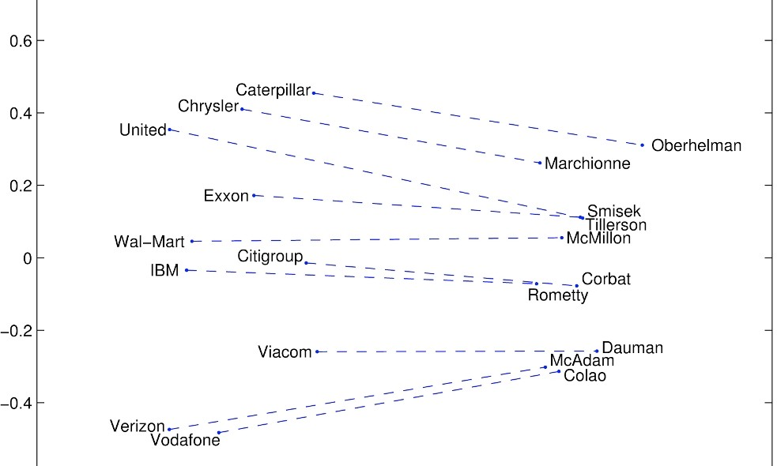
Glove Visualizations: Company - CEO
Christopher Manning & Abigail See

Slide 58

Glove Visualizations: Superlatives
37 Richard Socher 3/31/16
Christopher Manning & Abigail See

